Slide 1





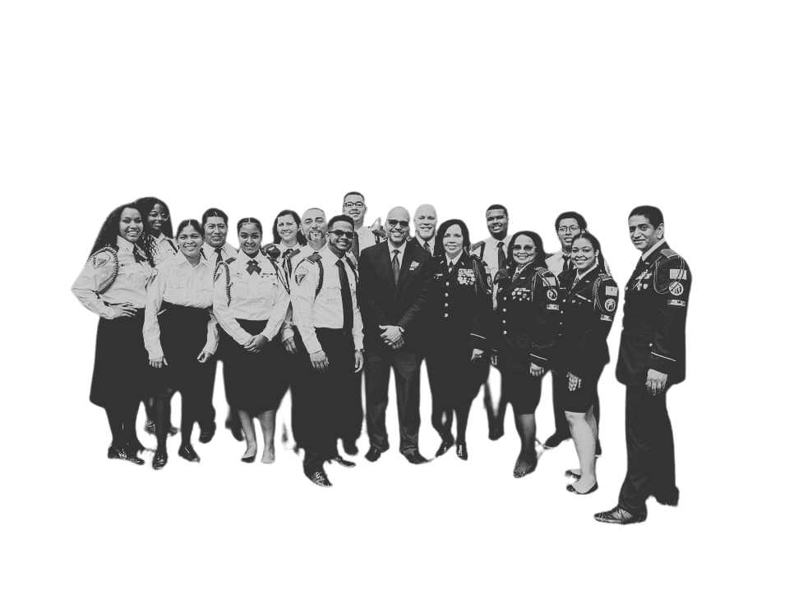

Southern New England Conference
Adventist Youth & Club Ministries
MEDICAL CADET CORPS
Uniform Guidelines
February 2025 Revision
www.snecyouth.com

Slide 2
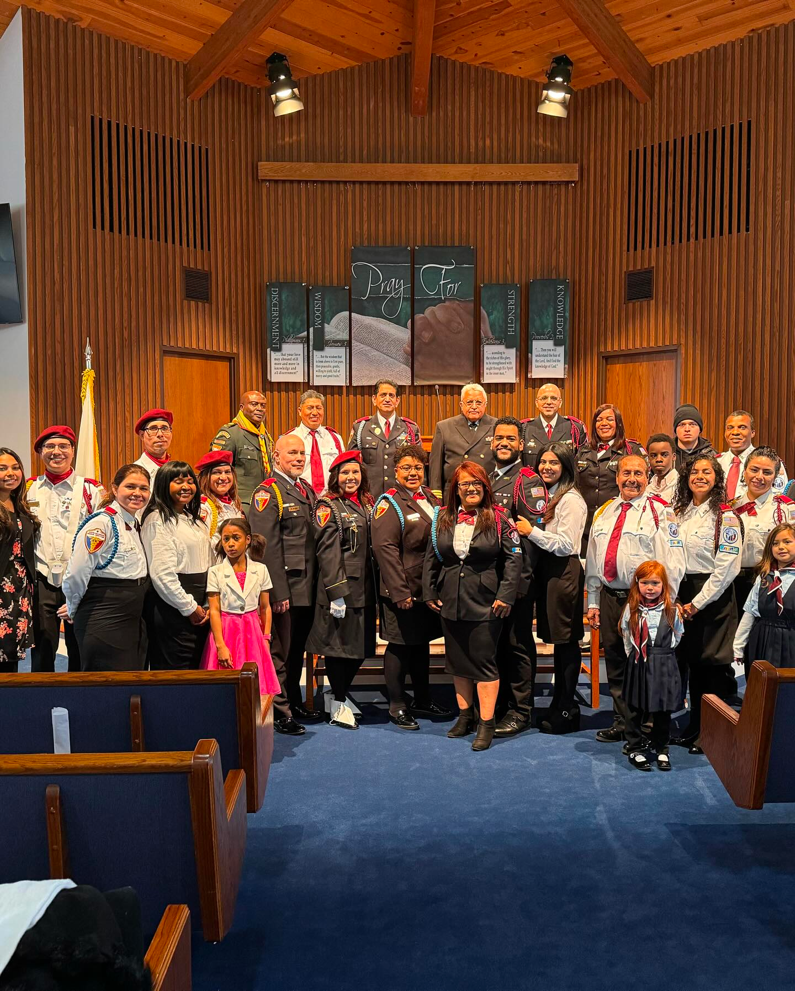
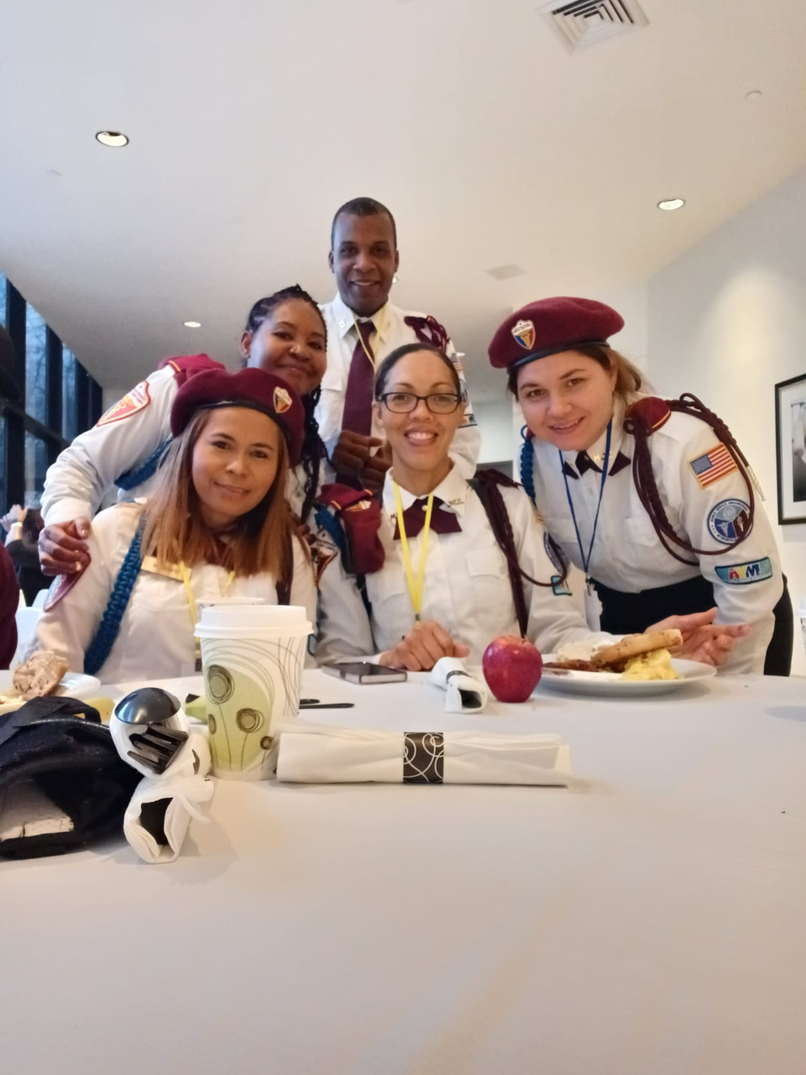
C
L
A
S
S
A

Slide 3
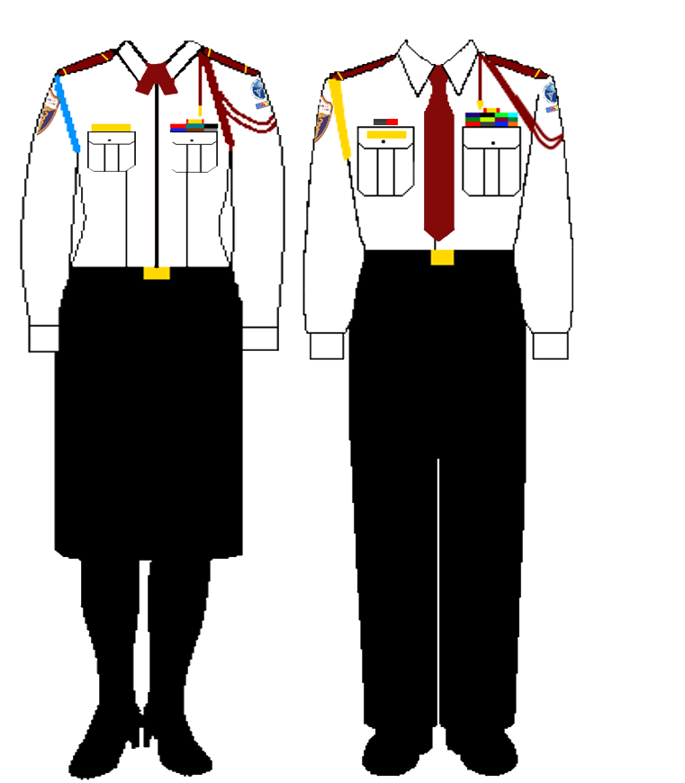
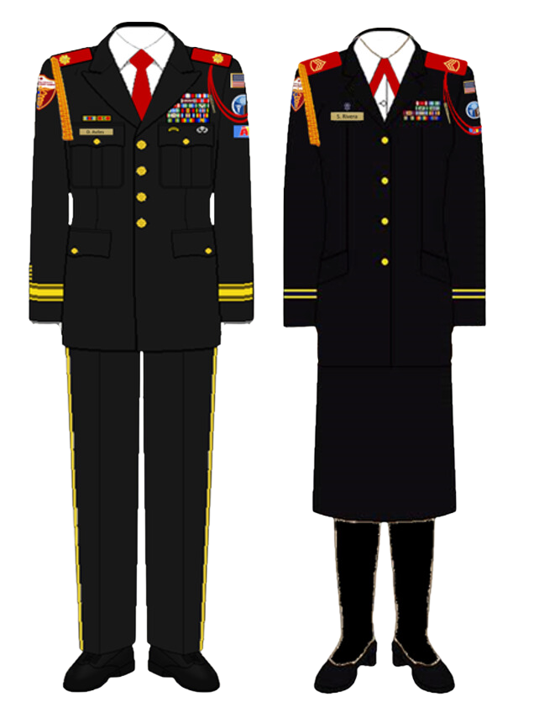
SDA
MCC
SDA
MCC
SDA
MCC
SDA
MCC
OPTION A
OPTION B

Slide 4
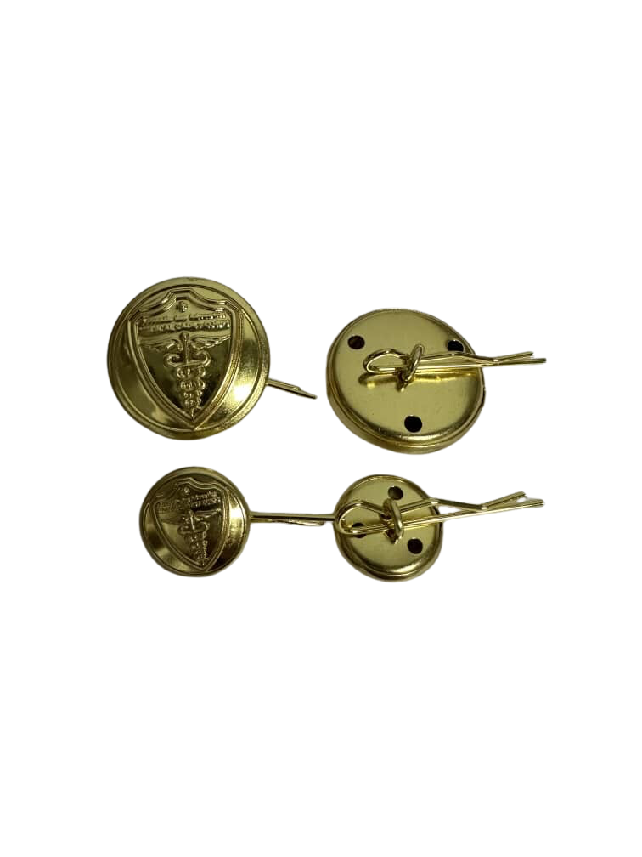
SDA
MCC
SDA
MCC
Replace gold buttons with MCC buttons

Slide 5
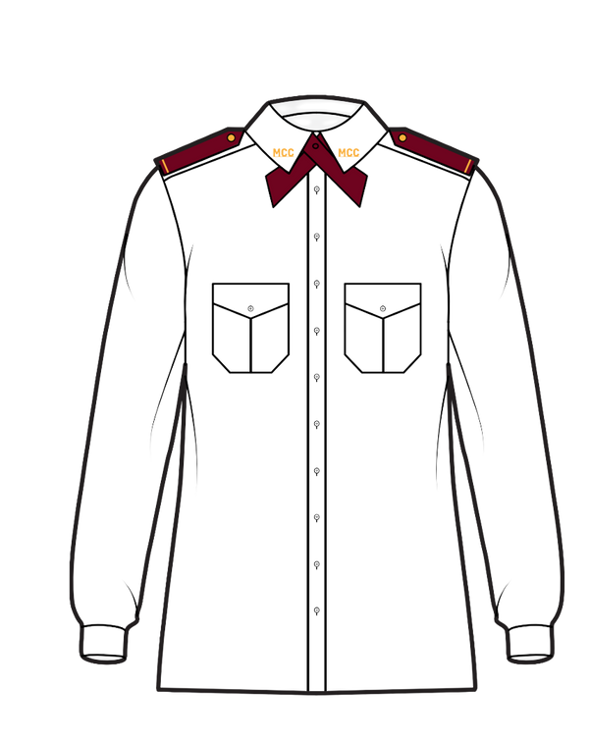
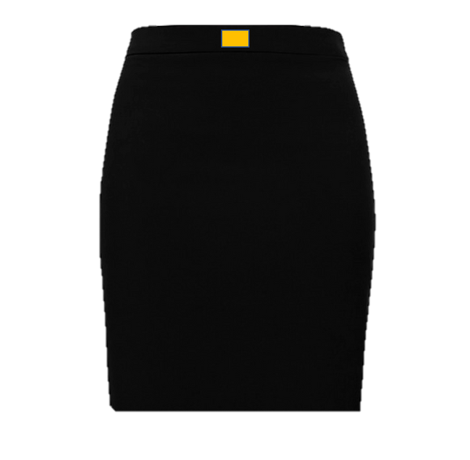
SDA
MCC
  Black skirt with belt strap (Knee length)
  White military shirt with long sleeves and epaulets
  Black nylons
  Maroon beret
  Gold Name Plate
  Black web belt with gold buckle
  Citation cords (maroon and company color)
  Maroon epaulets
  Maroon ribbon tie
  Gold Pins
  Black 2” block heel shoes
Female

Slide 6
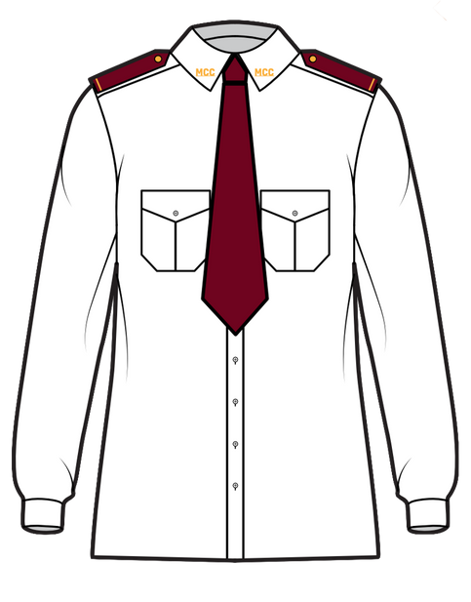
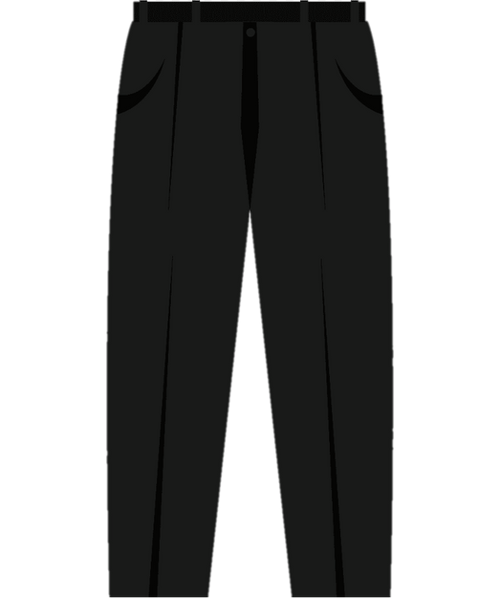
SDA
MCC
  Black dress pants with belt strap.
  White military shirt with long sleeves and epaulets.
  Black socks
  Maroon beret
  Gold Name Plate
  Belt web belt with gold buckle.
  Citation cords (maroon and company color)
  Maroon Epaulets
  Maroon tie
  Gold Pins
  Black dress shoes (no sneakers)
Male

Slide 7
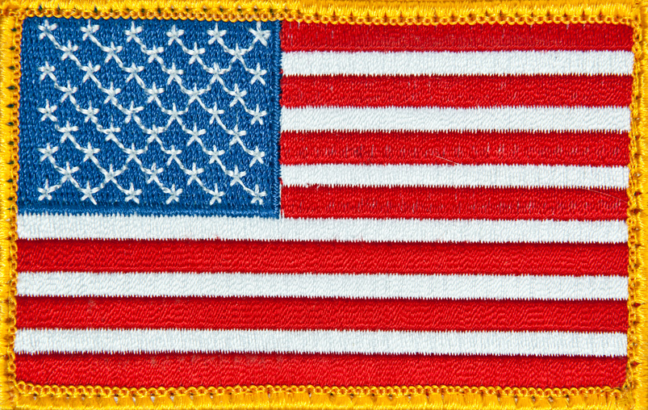


‘’
‘’
‘’
LEFT SLEEVE

Slide 8

‘’
RIGHT SLEEVE

Slide 9
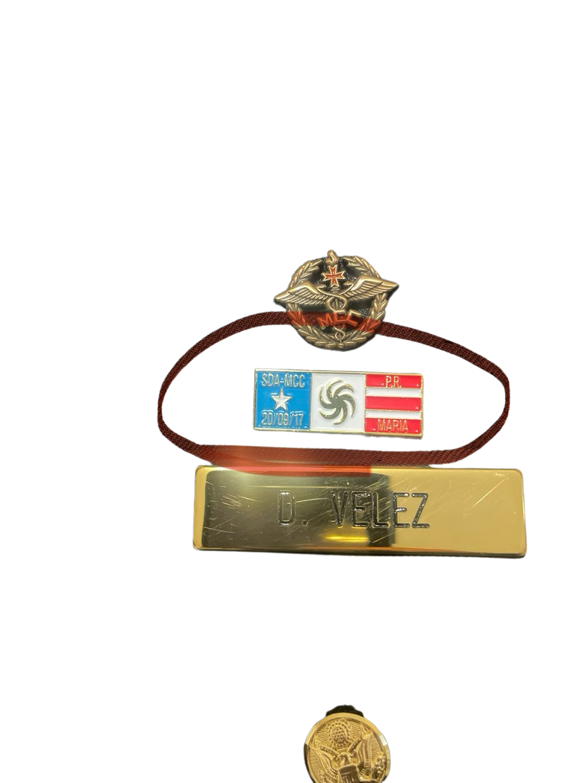


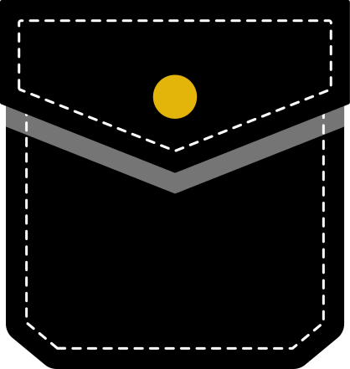
RIGHT POCKET
YOU CAN ONLY USE ONE (1) CITATION ABOVE YOUR RIGHT POCKET
IF YOU HAVE NOT EARNED ANY SPECIAL CITATIONS YOU WILL WEAR YOUR NAME TAG ABOVE THE POCKET

Slide 10







LEFT POCKET
ONLY PINS ALLOWED IN CLASS A UNFIR
DESMOND DOSS & LIFE SAVING AWARD CAN ONLY BE WORN WITH THE BLACK UNIFORM

Slide 11
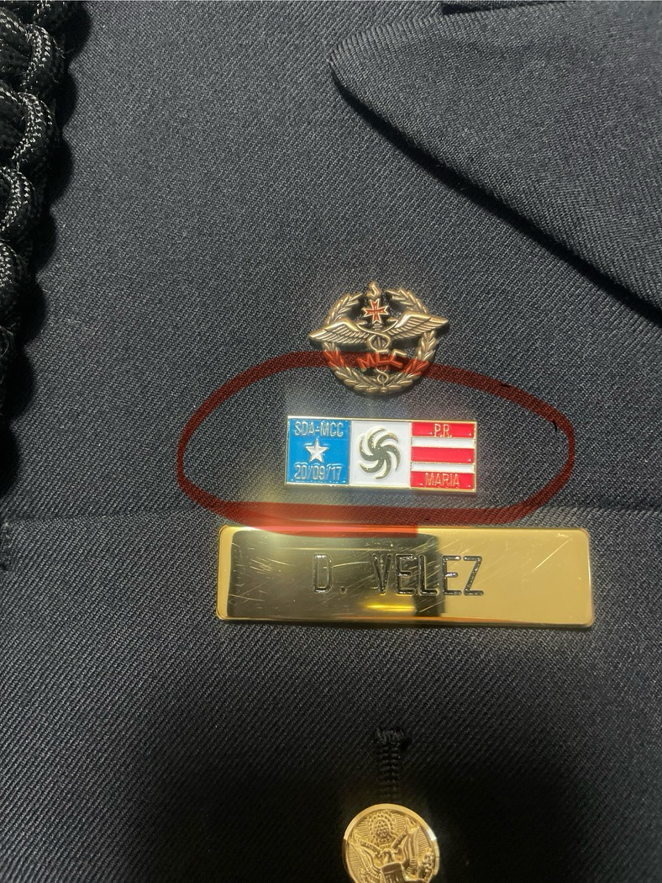
SPECIAL SERVICE CITATIONS
YOU CAN ONLY USE ONE (1) CITATION ABOVE YOUR RIGHT POCKET

Slide 12
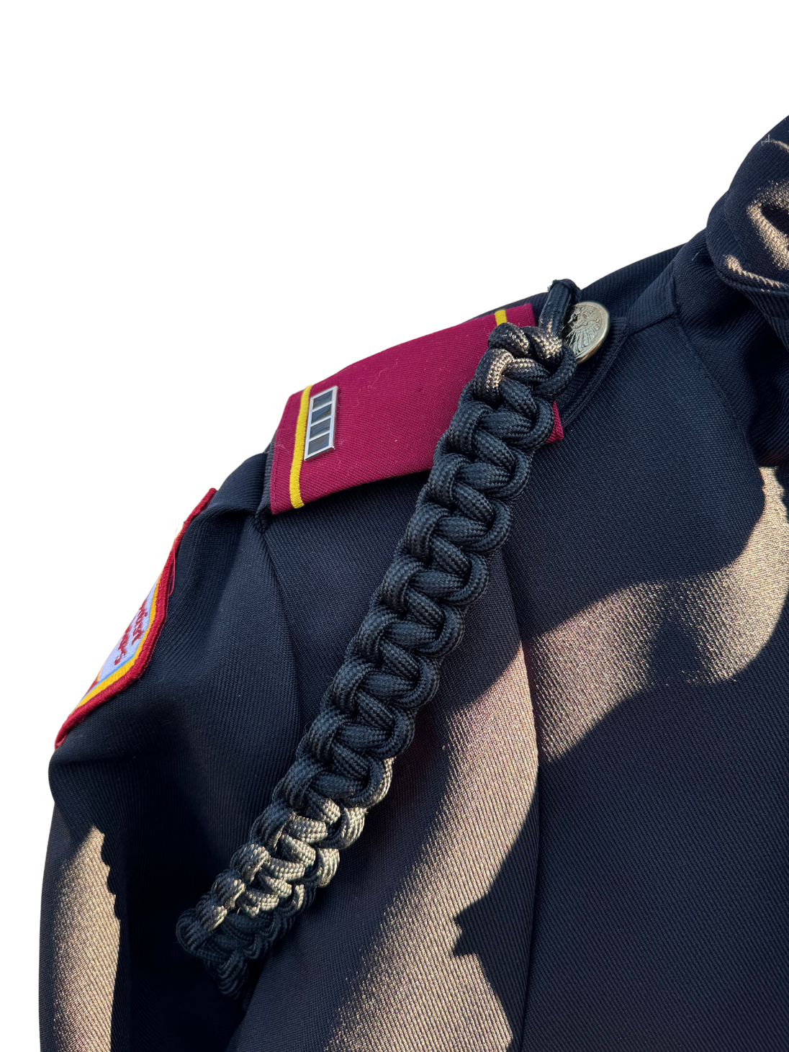
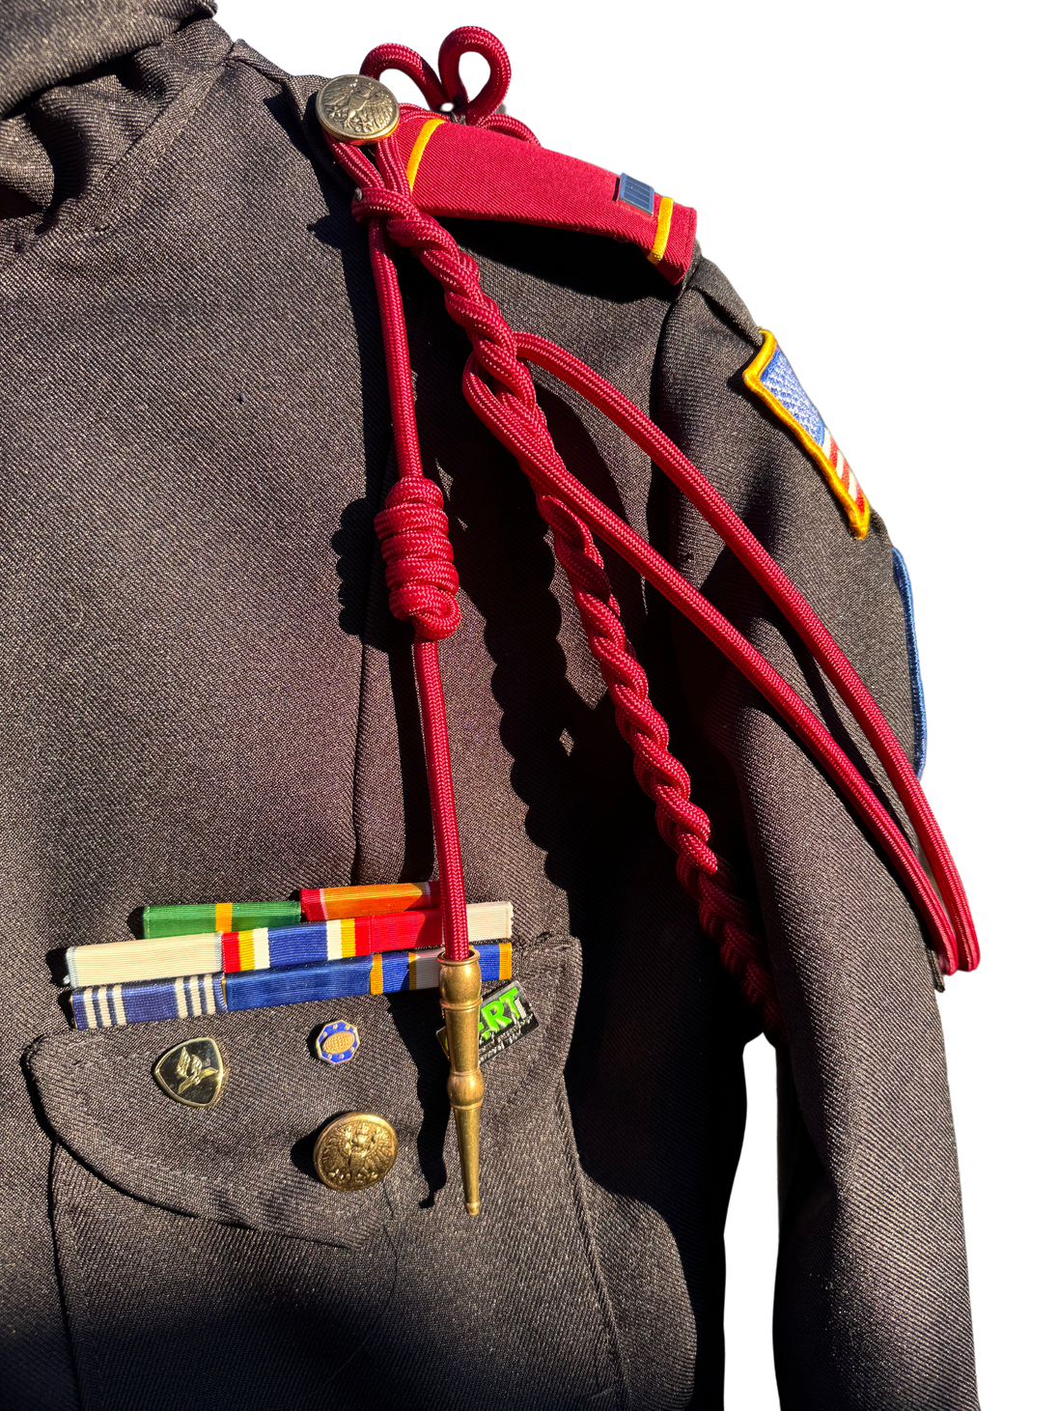
CITATION CORDS
MAROON
SHOULDER CORD
COMPANY COLOR
SHOULDER CORD

Slide 13
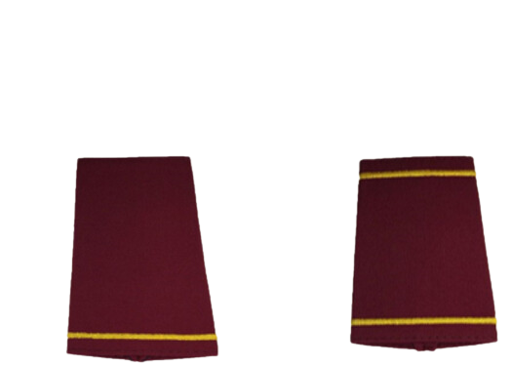

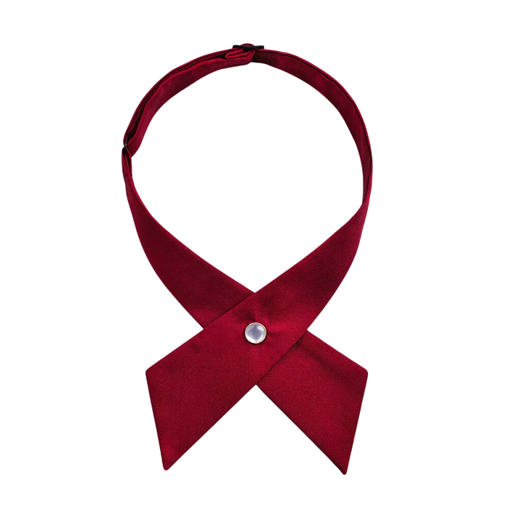

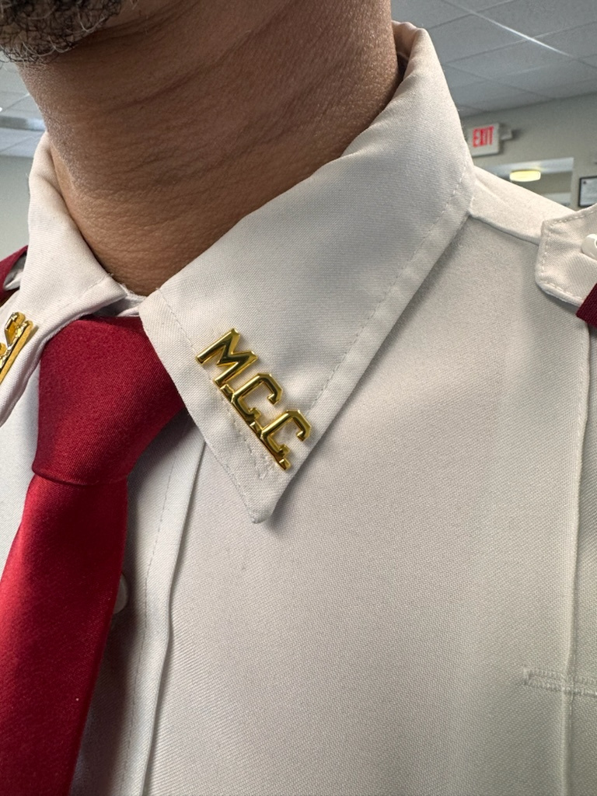
COLLAR & TIE
EPAULETS
SDA
MCC
SDA
MCC
Female
Female
Male
Male

Slide 14
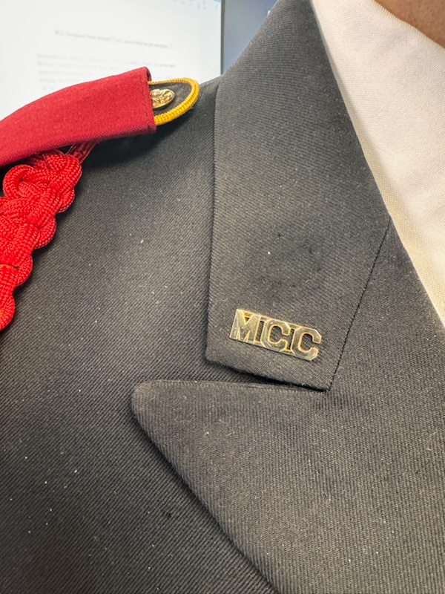
COLLAR & TIE PIN PLACEMENT

Slide 15



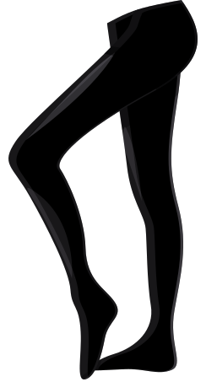
2 inch heels, all black block or
kitten heels with black nylons
Black Dress Shoes
Black Socks
Female
Male

Slide 16

C
L
A
S
S
B

Slide 17
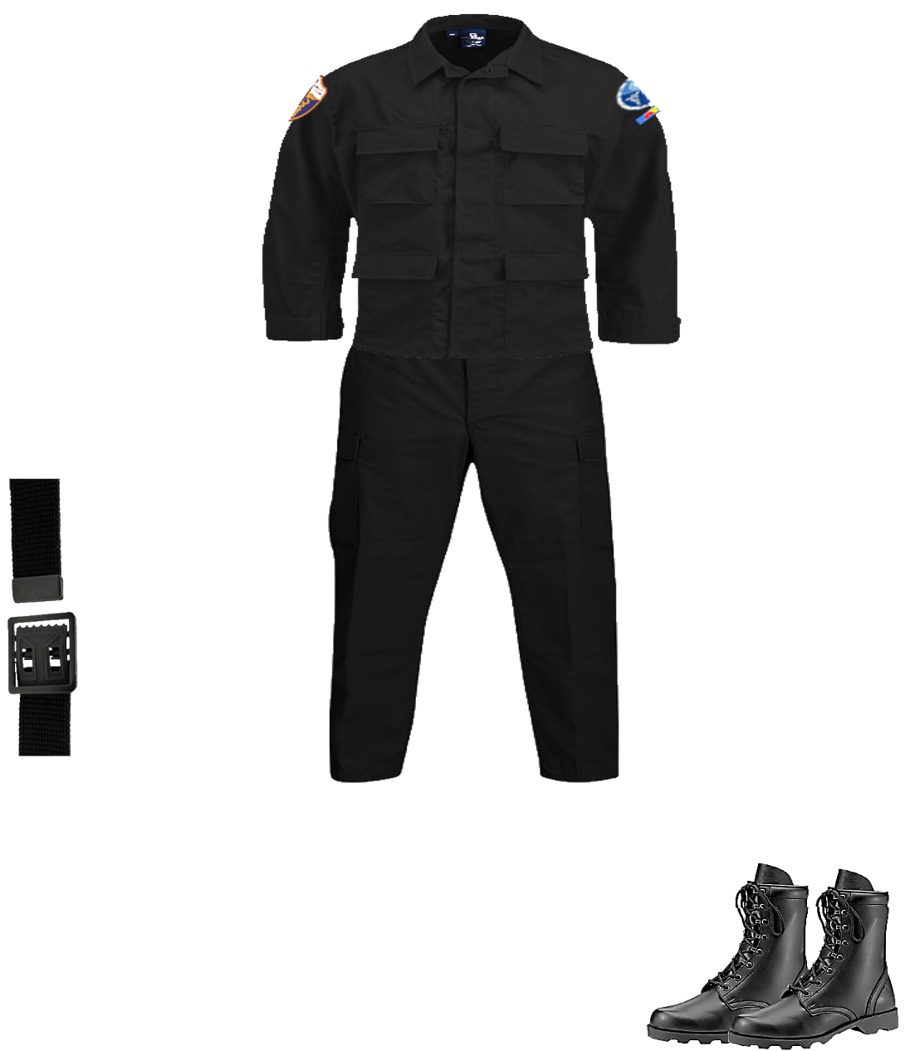
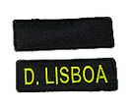


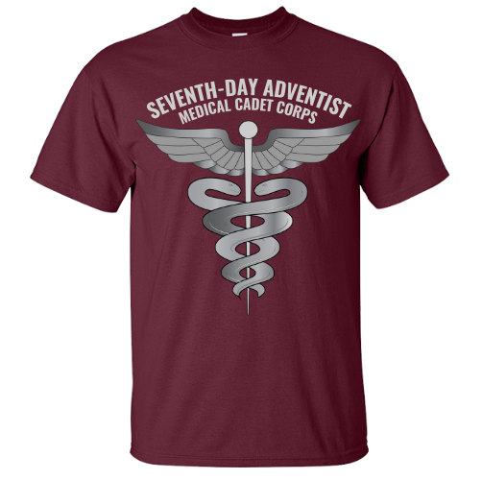
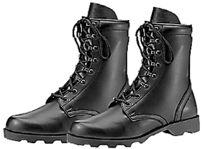
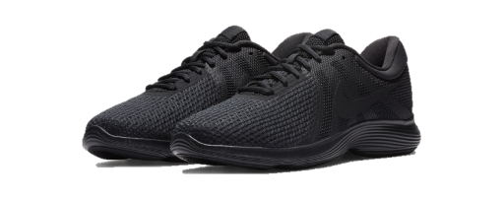
  Black BDU Jacket
  Black BDU Pants
  Maroon Shirt with Logo
  Black open face belt
  Black boot or black on black sneakers
  Black socks
  Name tag
  SDA MCC tag
  Same emblems as Class A uniform
  Black Baseball cap
Males & Females

Slide 18
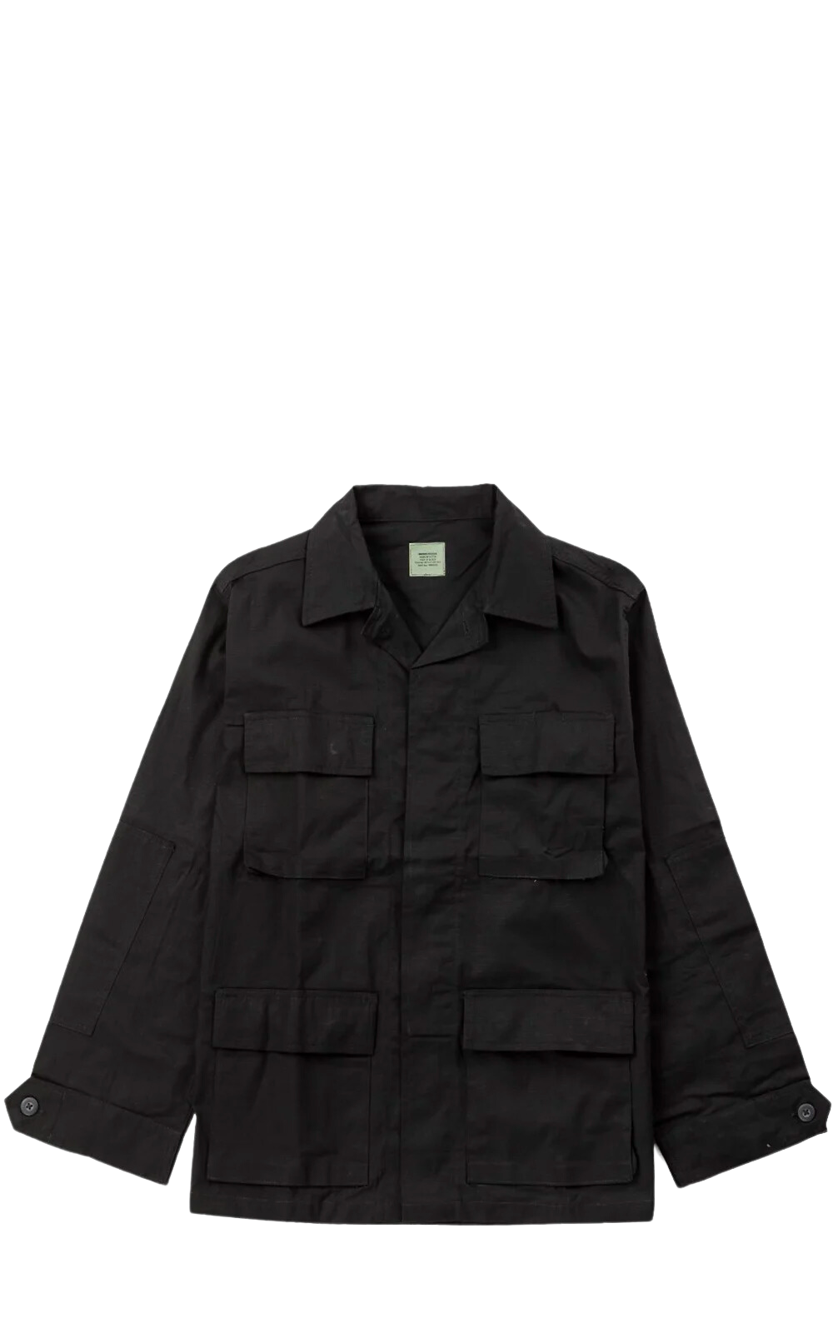
LEFT SLEEVE
RIGHT SLEEVE

Slide 19
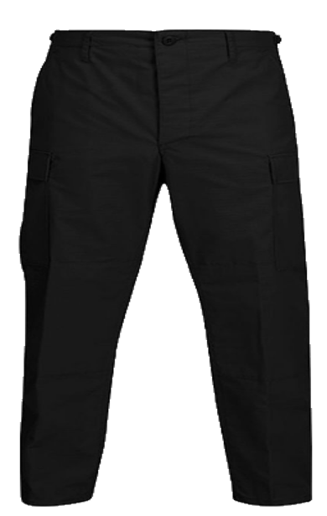

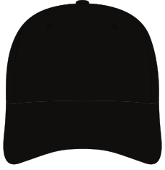



Slide 20

C
L
A
S
S
C

Slide 21
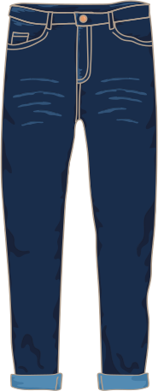
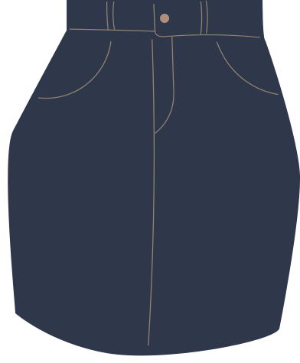


Slide 22
  Blue jeans ( not ripped)
  Maroon Shirt with Logo
  Black open face belt
  Black on black sneakers
  Black socks
  Black baseball cap

Slide 23
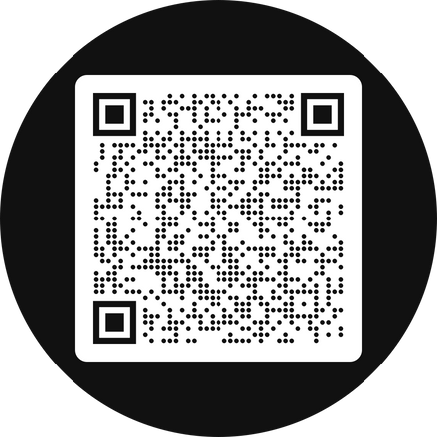
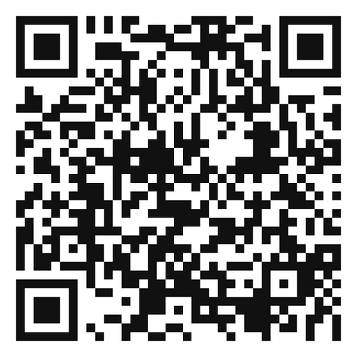
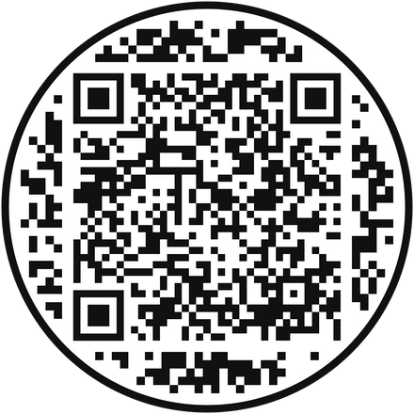
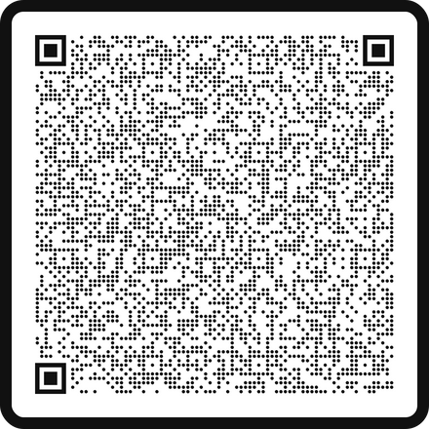
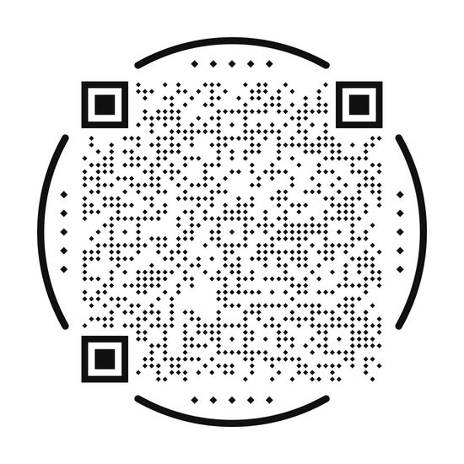
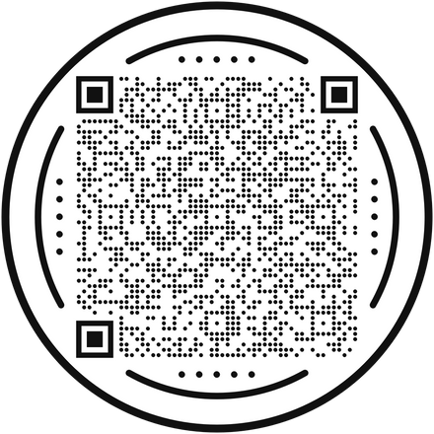
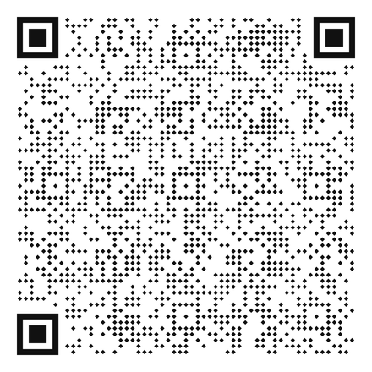
WHERE TO BUY UNIFORM SUPPLIES
PATHFINDER SHIRTS
SNEC YOUTH STORE
RANK PINS
BLACK BDU
SHOULDER CORDS
Company Colors:
Alpha – Sapphire
Bravo –LT Gold
Charlie – Columbia
Delta – Charcoal
Echo - Kelly Green
WORLD SERVICE ORGANIZATION STORE
WOOL BERETS

Slide 24
Uniform Questions
Glorimar “Glory” Teixeira
(203) 727-4424
gteixeira@sneconline.org
www.snecyouth.com

